Slide 1

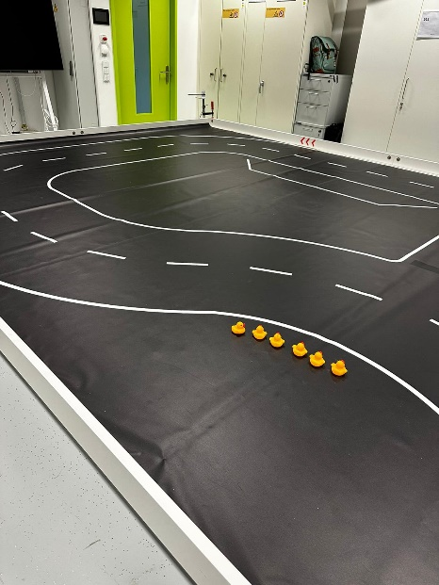
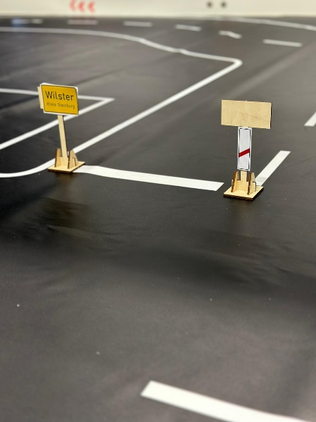
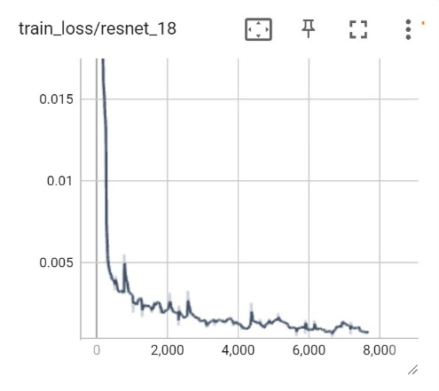
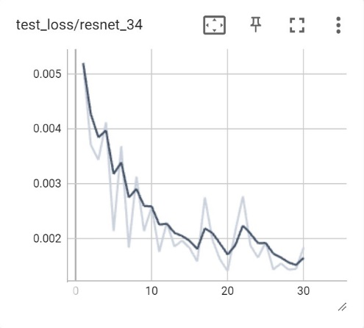
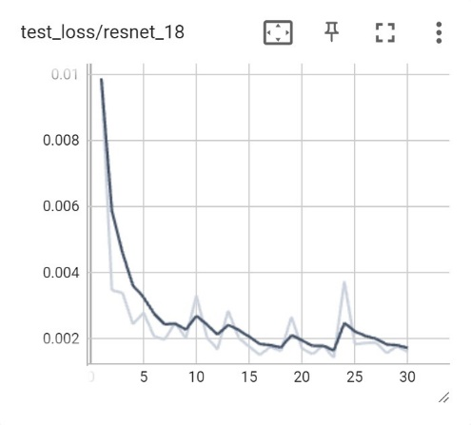
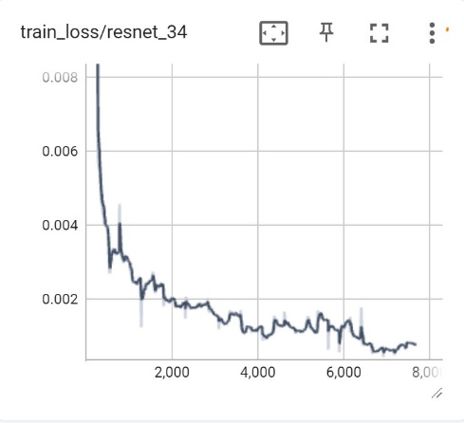
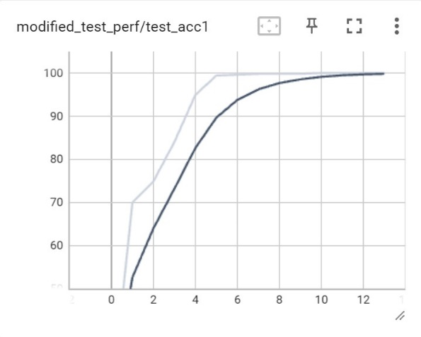

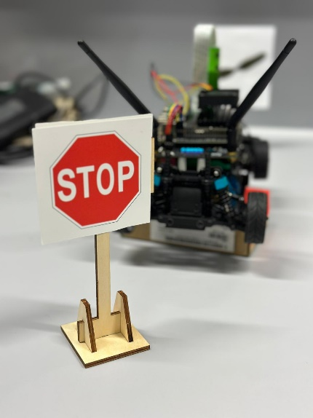
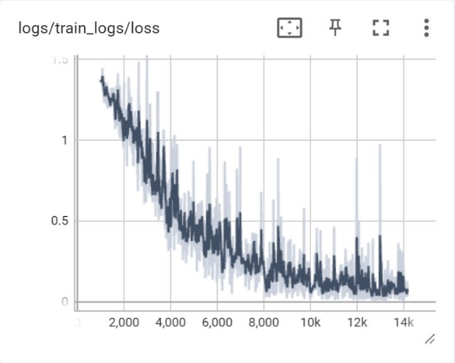
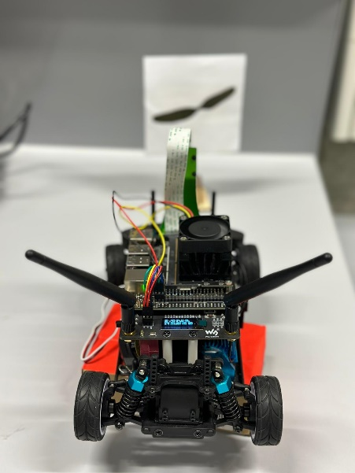
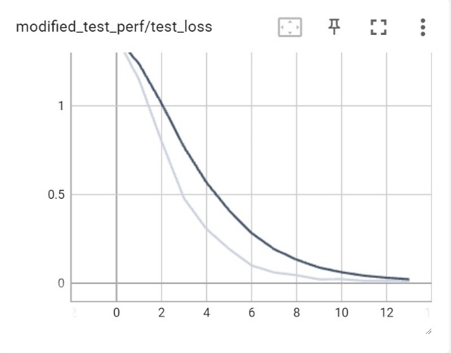
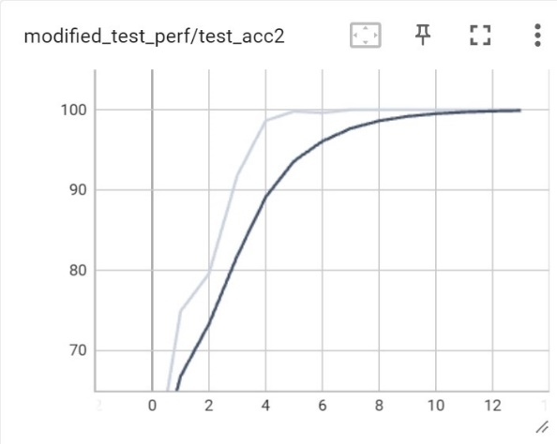

Group 3
Tao Zhao
Ali Beiti Aydenlou
Ferhad Gulizada
Negin Amiri
Danial Rafiee
Farm Guard
Cognitive Behavior
Summer School
Embedded Systems Engineering
Test Environment
Road with 1:10 scale of real environment
3.5m * 7.5m
Including turning and side signs
Different light conditions
Various speeds posible
Road Following
Data Gathering (JupyterLab environment)
2500 images in total
2000 training
Testing 500
Data Labeling
Return x and y
Choosing The Network
ResNet18 and ResNet34
Data Augmentation
Training and Testing The Network
Test in The Real Environment
Classification
4 main categories of signs
Augmentation the data

